Slide 1
Siri Farming
A Farmer Friendly website

Slide 2
Main problems of the farmers
Lack of information about the modern technology
Lack of knowledge about the organic and natural fertilizer
Financial loss by the so many intermediate dealers
Ignoring the government facilities
Lack of Knowledge about Free Energy sources and equipments

Slide 3
Main Intension…
Help the farmer through IT.
Provide information about efficient Technology for the modern agriculture.
Introducing Indian traditional Food production (Like Millets)
Mainly focusing Indian Rural farmers
Organic Farming intension(Information and suggestion based blog).

Slide 4
What this website will do?
Farmers product Bidding
Dealers connection
Government available Facility.
Farming Requirements.
Equipment and production guidelines.

Slide 5
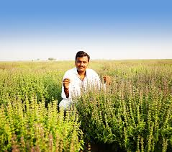
Uses for farmers
This website will be use for farmers & growth of their financiancial status.

Slide 6
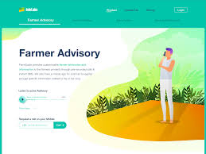
Platform & languages :
HTML, CSS, PHP, MYSQL, JavaScript

Slide 7
Thank You

